Slide 1
1
SPL – 1 Midterm Presentation
Prepared by:
Mohammad Ismail Hossain
BSSE - 1433
Topic:
Typing Master: An Interactive Typing Tutor and Typing Game
Supervised by:
Dr. Emon Kumar Dey

Slide 2
2
Importance of Typing proficiency
Enhanced Typing Skill
Increase Productivity
Competitive Advantage

Slide 3
3
Introduction of this project
“Typing tutor and Typing Game” project is an interactive application that aims to improve users’ typing skill through 3 major features.
Typing Tutorial feature provides some technique and helpful rules which can help users to improve typing skill.
Practice mode provides some structured exercises like key typing, word typing, paragraph typing.
Typing Game feature adds a fun and interesting experience for users to test their accuracy and speed in an exciting game environment.

Slide 4
4
Objective of this Project
Improve Typing Speed
Improve Typing Accuracy
Performance Tracking
Performance Analysis
Provide Feedback

Slide 5
5
The Problems and Challenges
Register & Login System
Accuracy & Speed Test
Users Performance Tracking
Performance Analysis
Bangla language support
Implement a timer
File Handling Operations

Slide 6
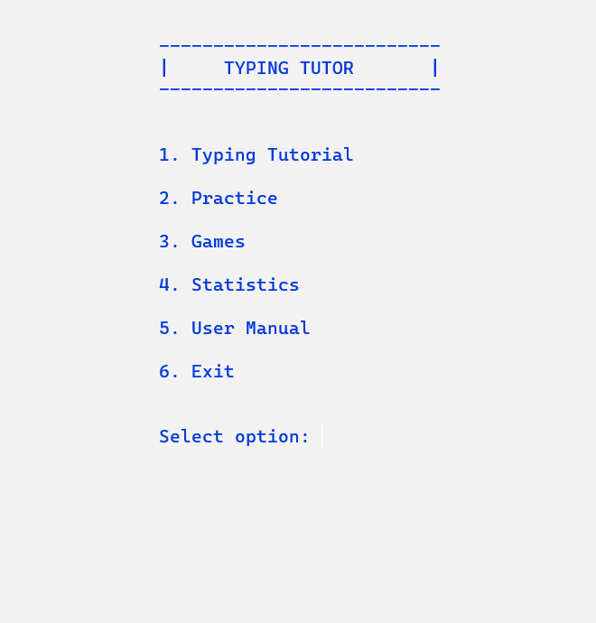
7
Main Menu
Users can select their required part.

Slide 7
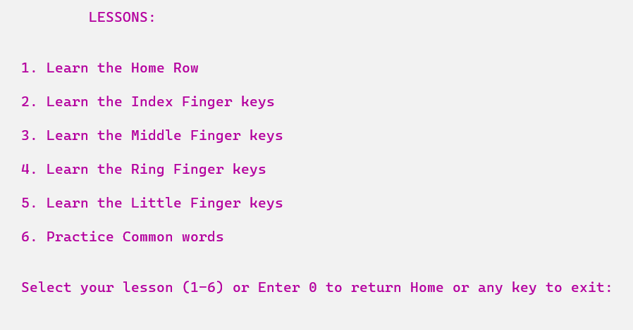
8
Typing Tutorial
All keys are divided into 5 lessons
Some common words to practice

Slide 8
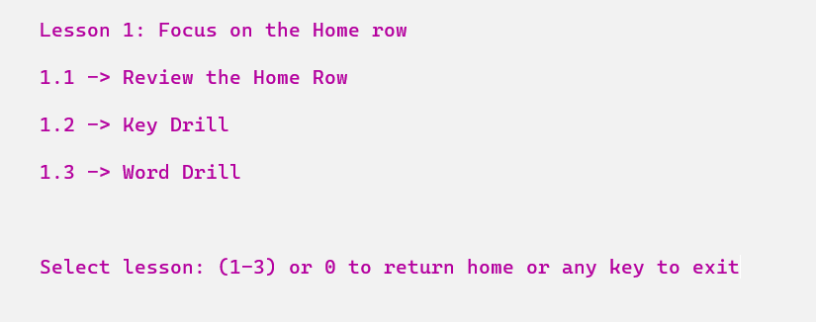
9
Feature in each Lesson
Interactively learn the keys
Practice on some randomly generated keys / words

Slide 9
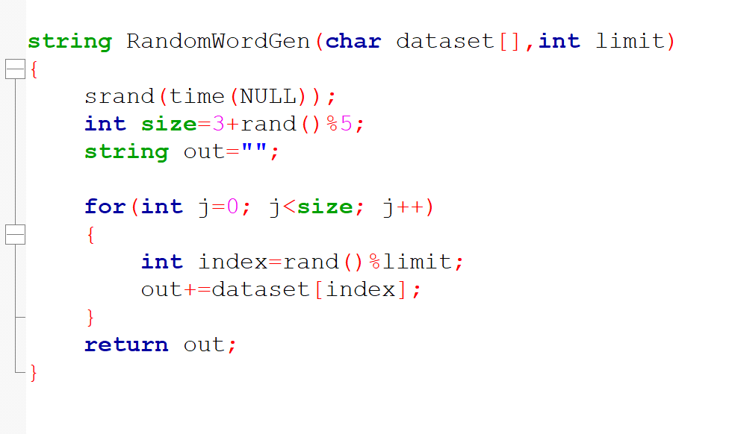
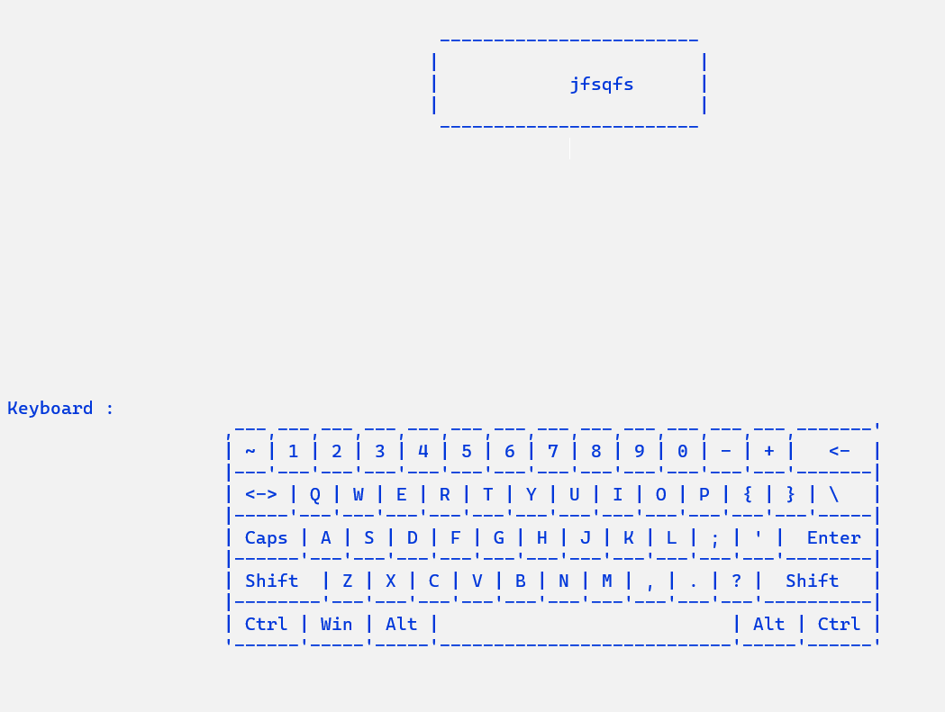
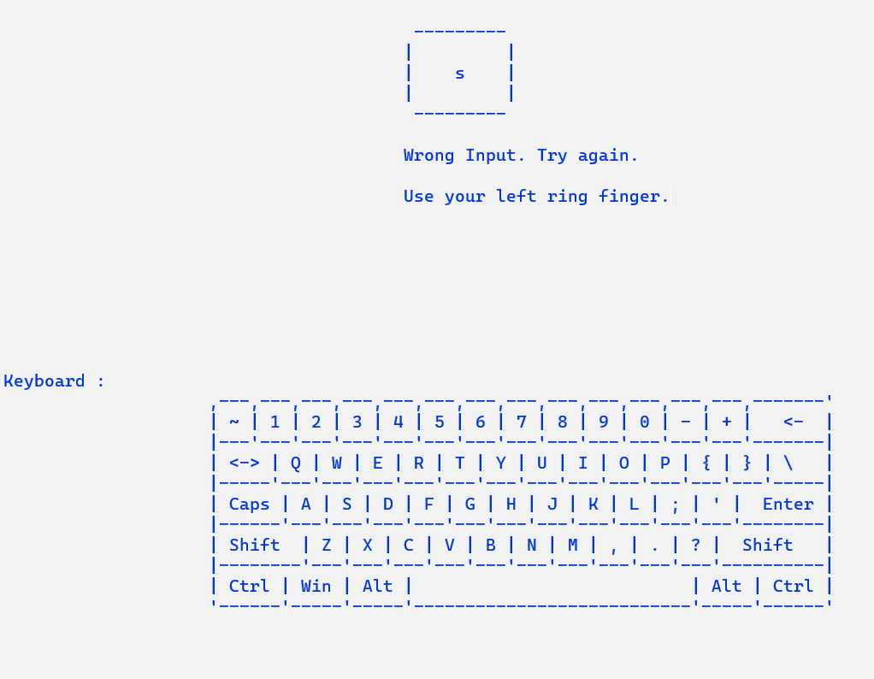
10
Random Word Generate
One of the most important functionalities in my project was to generate a random word / alphabet.

Slide 10
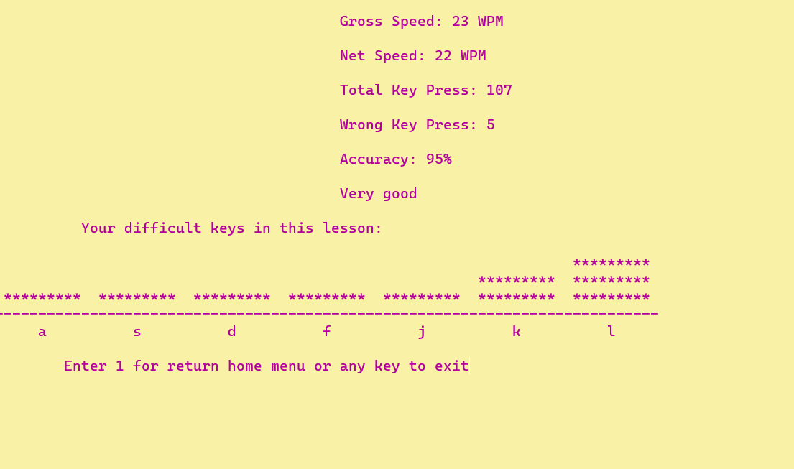
11
Performance Result
Gross Speed
Net Speed
Total Key Press
Wrong Key Press
Accuracy
Comment
Difficult Key Analysis using Histogram

Slide 11
15
Sign Up & Log In System
User Registration: Allow users to create an account by providing essential information username and password.
Secure Authentication: Password Encryption technique to store passwords securely.

Slide 12
Typing Time Calculation and Timer

Slide 13
Bangla support

Slide 14
17
Performance Analysis
Each users’ performance will be stored in separate text file
Typing accuracy & speed analysis
Progress Analysis
Typing pattern analysis

Slide 15
User Interface

Slide 16
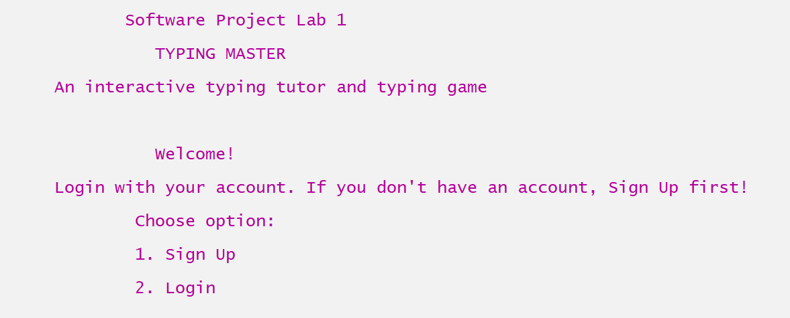
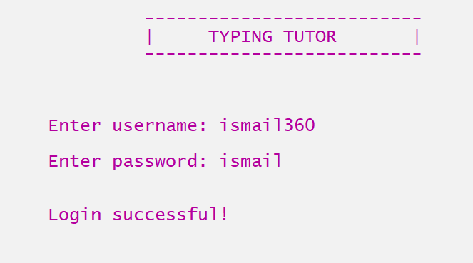
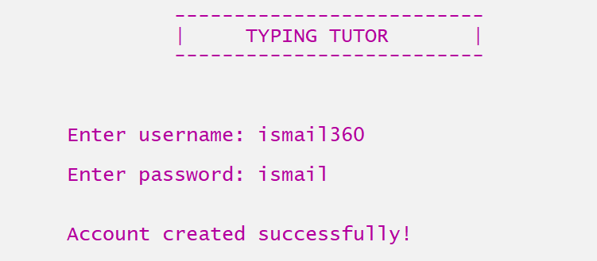
LogIn System

Slide 17
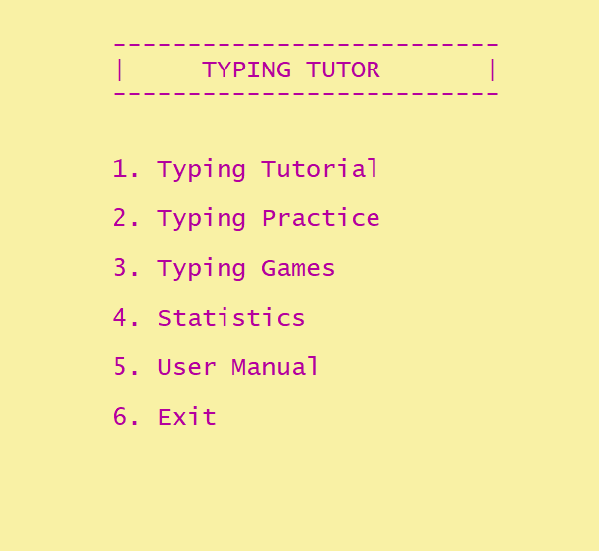
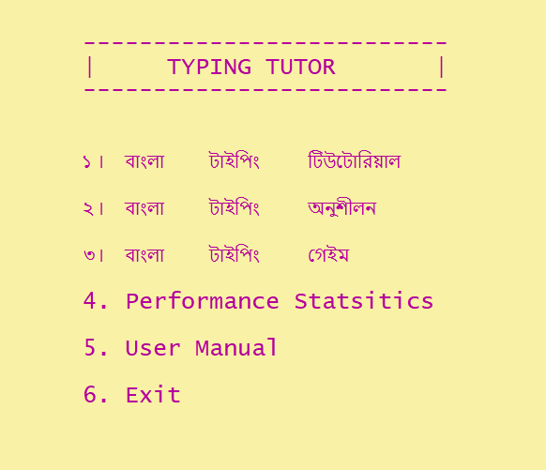
Home Page
Home Page (English)
Home Page (Bangla)

Slide 18
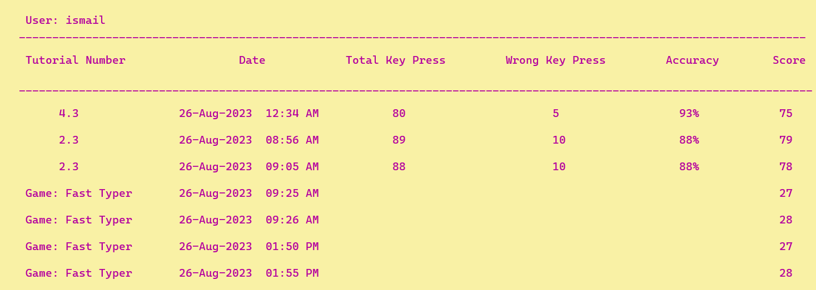
12
Statistics: Performance History
Users performance will be stored in a text file.

Slide 19
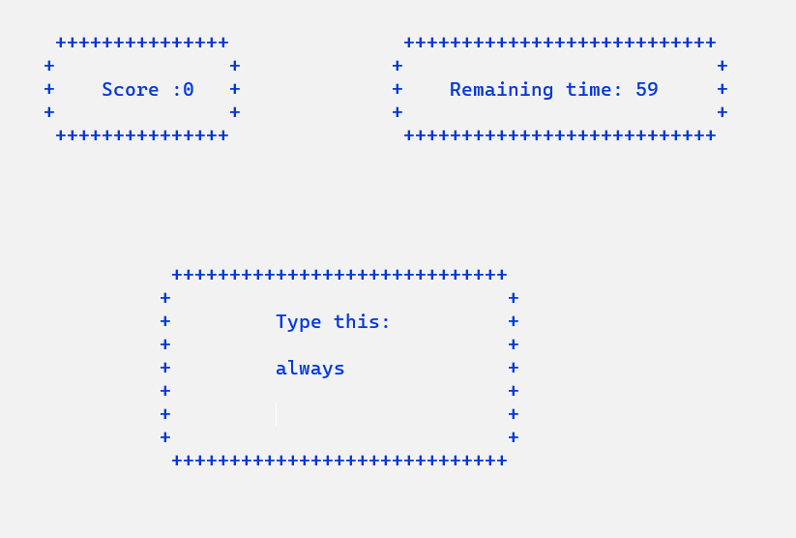
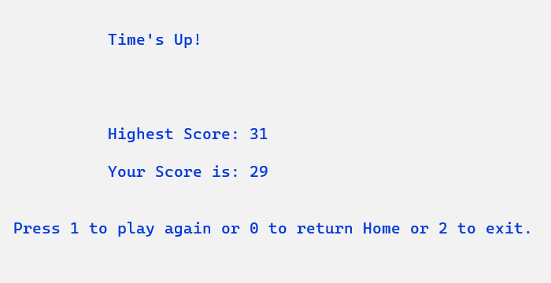
13
Game: Fast Typer
user will play for 60 seconds to type word as much as he can.
Highest score will be saved.
Words are taken from a text file

Slide 20
20
Thank You

